Slide 1
Asl sensor based report
Done by :Hayde Elshike alawad

Slide 2
The bolck diagram for the work
Design of the circuit
Embed of the new data
Running the algorithms

Slide 3
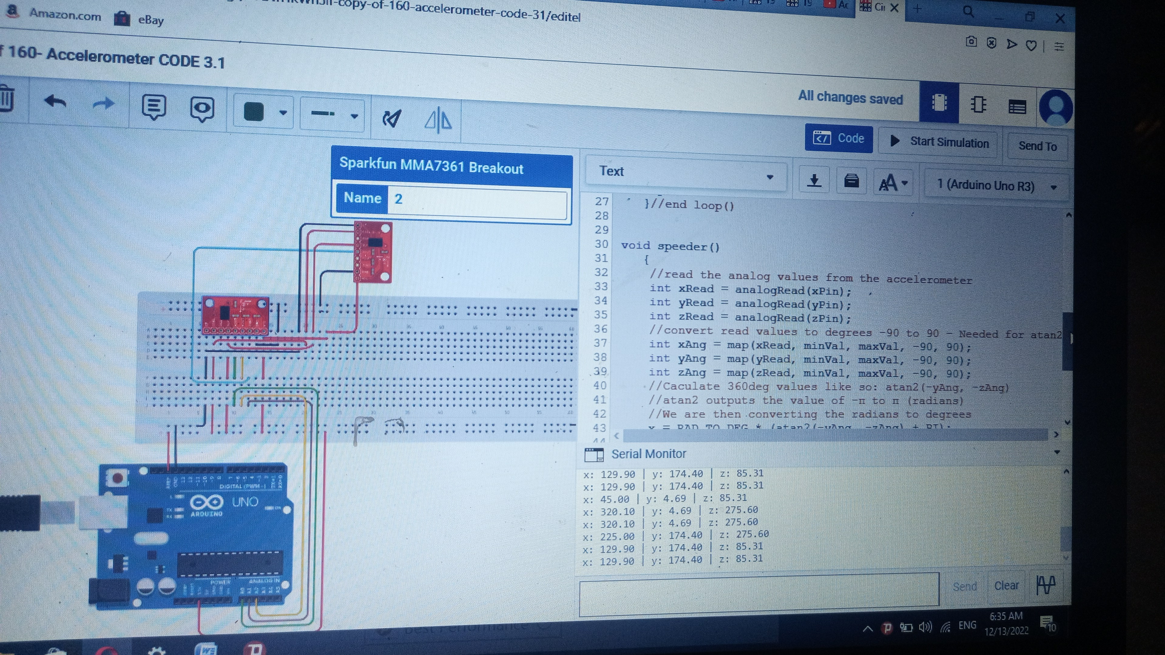
1)Circuit design

Slide 4
1,1)Components
Arduino Uno :as microcontroller
Two acclerometers: one for the axes informations and the other for the rotation around the axes
wires

Slide 5
2)Embed the new data
Each letter has 6 new data which make the recognition of letters more accurate which are:
X axis, y axis, z axis
X rotation, y rotation, z rotation
This data have been embedded to the excal file of the old data

Slide 6
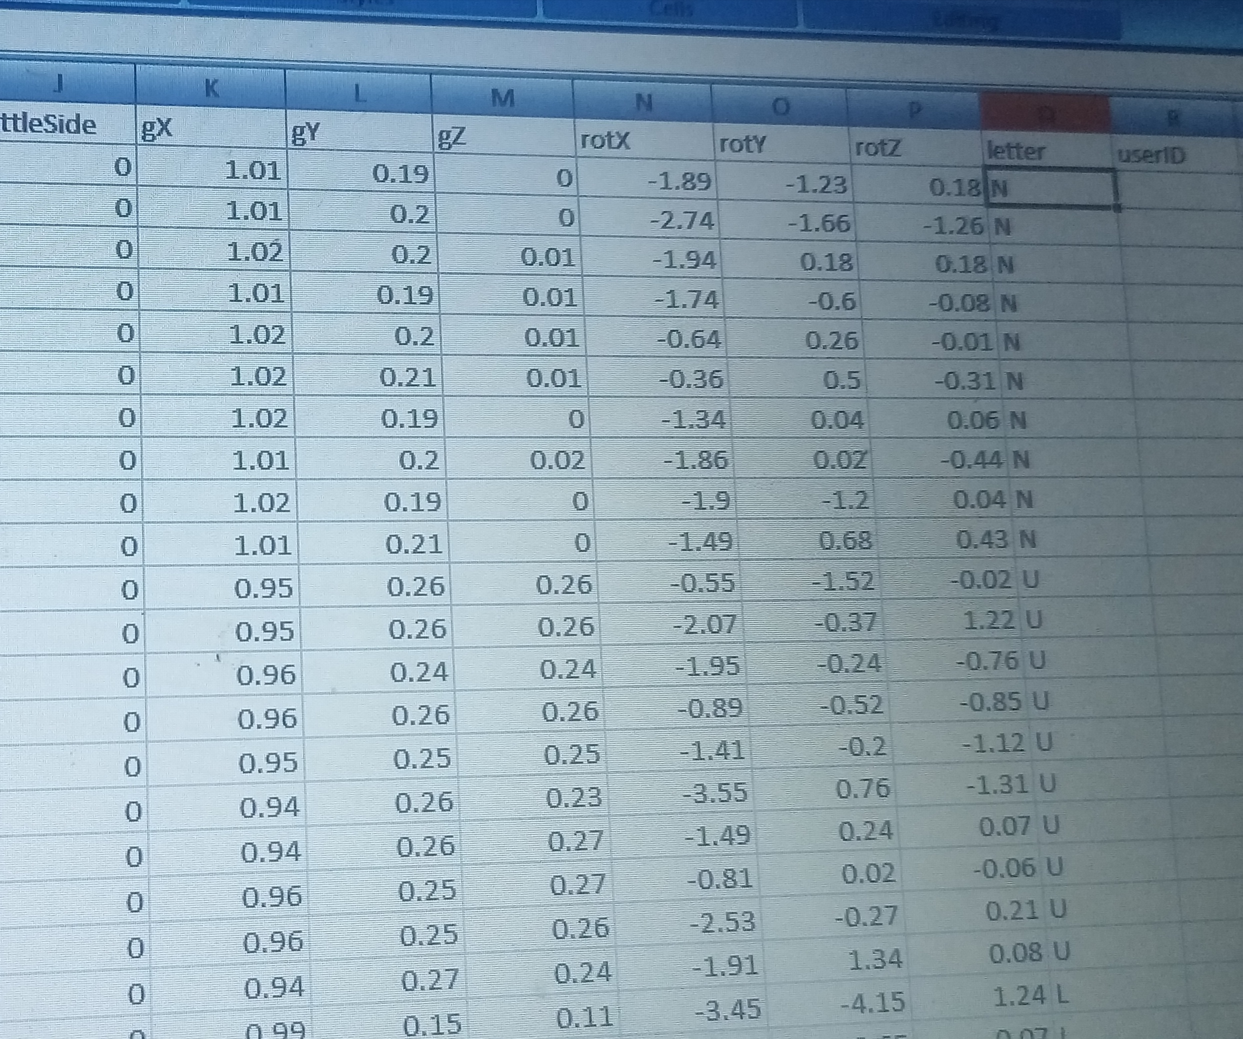
Figure (2)show the data file

Slide 7
3)Running of algorithms
3,1) the data was tested by svm algorithm
It give accuracy 96%

Slide 8
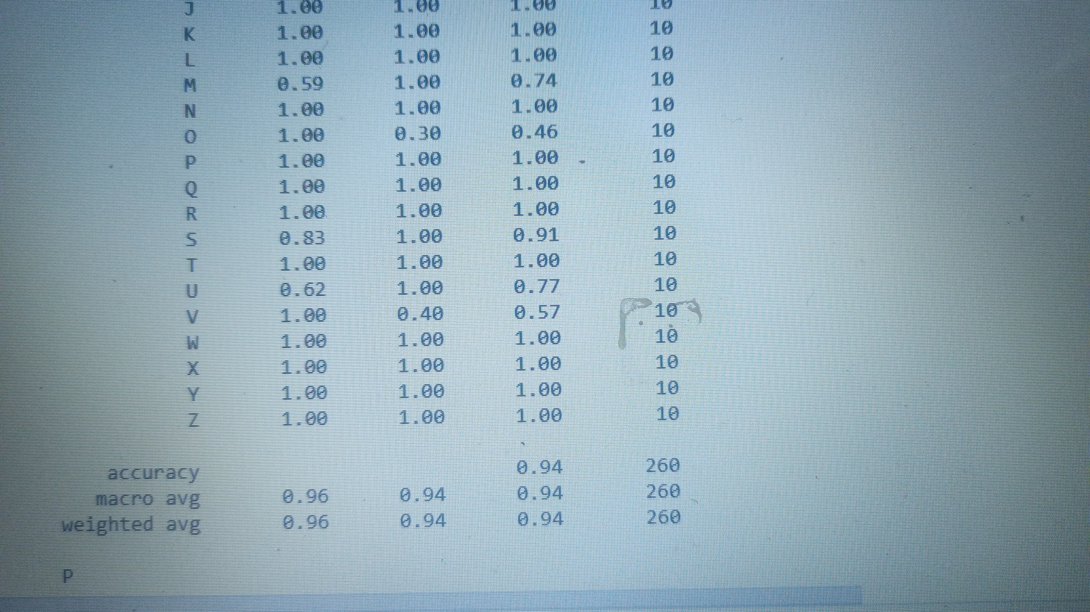
Figure (1)show The algorithm result

Slide 9
The affect of adding the mpu data
The sintific paper experiment (mpu+flex sensor data) | Our experiment (flex sensor) | Our experiment (mpu+flex sensor)
94.9% accuracy | 95%accuracy | 96%accuracy

Slide 10
3)Running the algorithms
3,2)the dicision tree
Stil work on it

Slide 11
Problems encountered during work
First the code wasn’t good to satisfy our need(solved)
The Overfit of decision tree algorithm (still work on it)

Slide 12
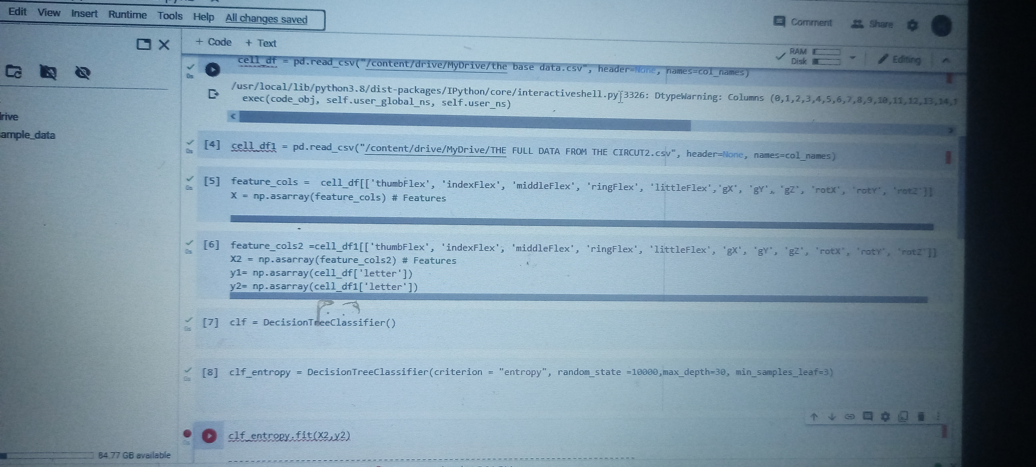
Figure (2)show the first attempt to solve the decision tree Overfit

Slide 13
Thank you

